Slide 1

Engineering Placements Analysis Through Data Visualization
By Group-9
Syed Zeeshan Ahsan -02208117
Fawaz Mokthar- 02188727

Slide 2

Introduction
The analysis focuses on understanding factors influencing engineering placements using data from a University's On-Campus Placement Records for 2013 and 2014.
The dataset, sourced from Kaggle, includes features such as age, gender, stream, internships, CGPA, hostel accommodation, and placement status.
Goals include providing insights for students, universities, and recruiters to aid in career planning, program enhancement, and optimizing hiring processes.
Data visualization techniques like bar charts, area charts, and gauge charts will be used to visually represent key factors impacting placement outcomes.

Slide 3
Task
- What
The dataset consists of records from a University's On-Campus Placement for the years 2013 and 2014.
It includes information on students' age, gender, academic stream, number of internships, CGPA, hostel accommodation status, and academic history (backlogs).
The analysis aims to understand how these factors influence placement outcomes.
By examining these factors, we can identify trends and patterns that may help improve placement success rates.

Slide 4

-Why
Helps students understand the key factors that contribute to successful placements.
Enables universities to tailor their programs to better align with industry needs.
Allows recruiters to target their efforts more effectively based on historical data.
Ultimately aims to improve placement success rates and outcomes for all parties involved.

Slide 5

-How
Use bar charts to compare placement status across different engineering streams.
Employ area charts to visualize the trend of internships completed by students and their corresponding placement outcomes.
Utilize gauge charts to present the overall placement percentage, providing a quick snapshot of placement success rates.

Slide 6
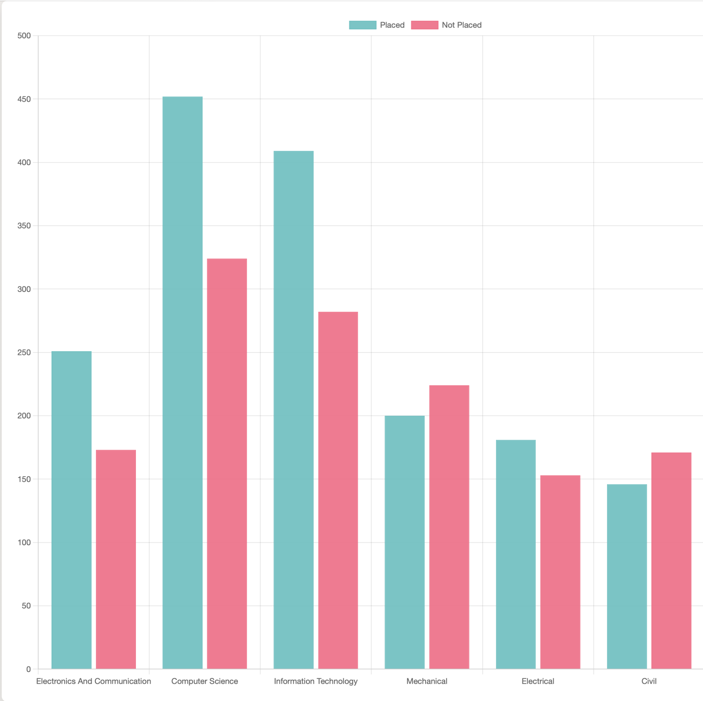
Bar Chart
Illustrates placement status (Placed or Not Placed) for each engineering stream.
Provides insights into placement success rates for each stream.
Highlights potential areas for improvement in placement outcomes for different streams.

Slide 7
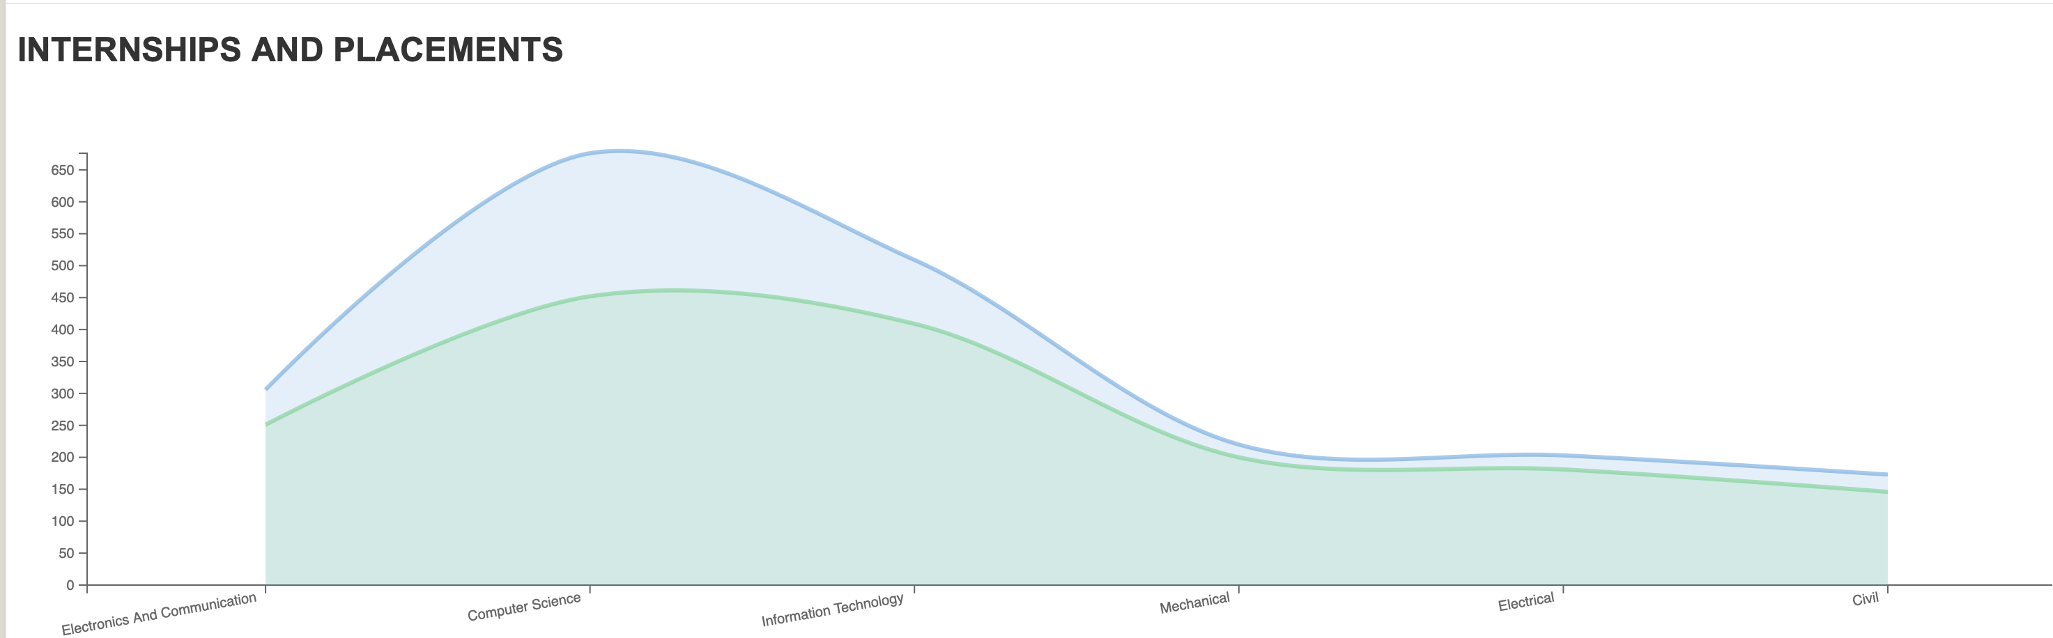
Area chart
Displays the trend of internships completed by students for each engineering stream.
Shows the corresponding placement outcomes (Placed or Not Placed) for students with different numbers of internships.
Helps identify if students with more internships have higher placement rates and how this varies across engineering streams.

Slide 8
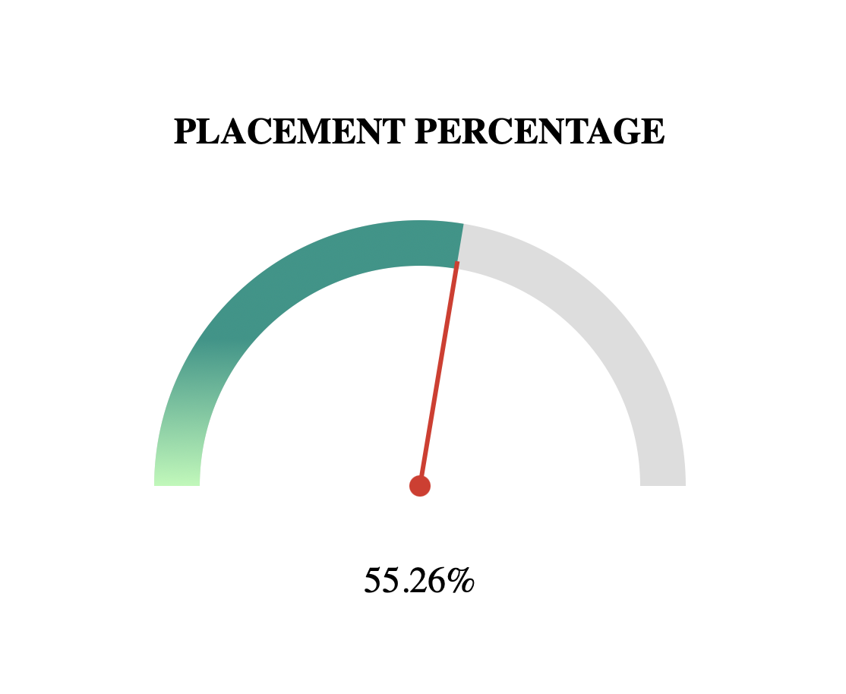
Gauge Chart
Presents the overall placement percentage of students across all engineering streams.
Offers a quick snapshot of the placement success rate for the dataset.
Provides a high-level overview of the placement outcomes, indicating the overall success rate.

Slide 9
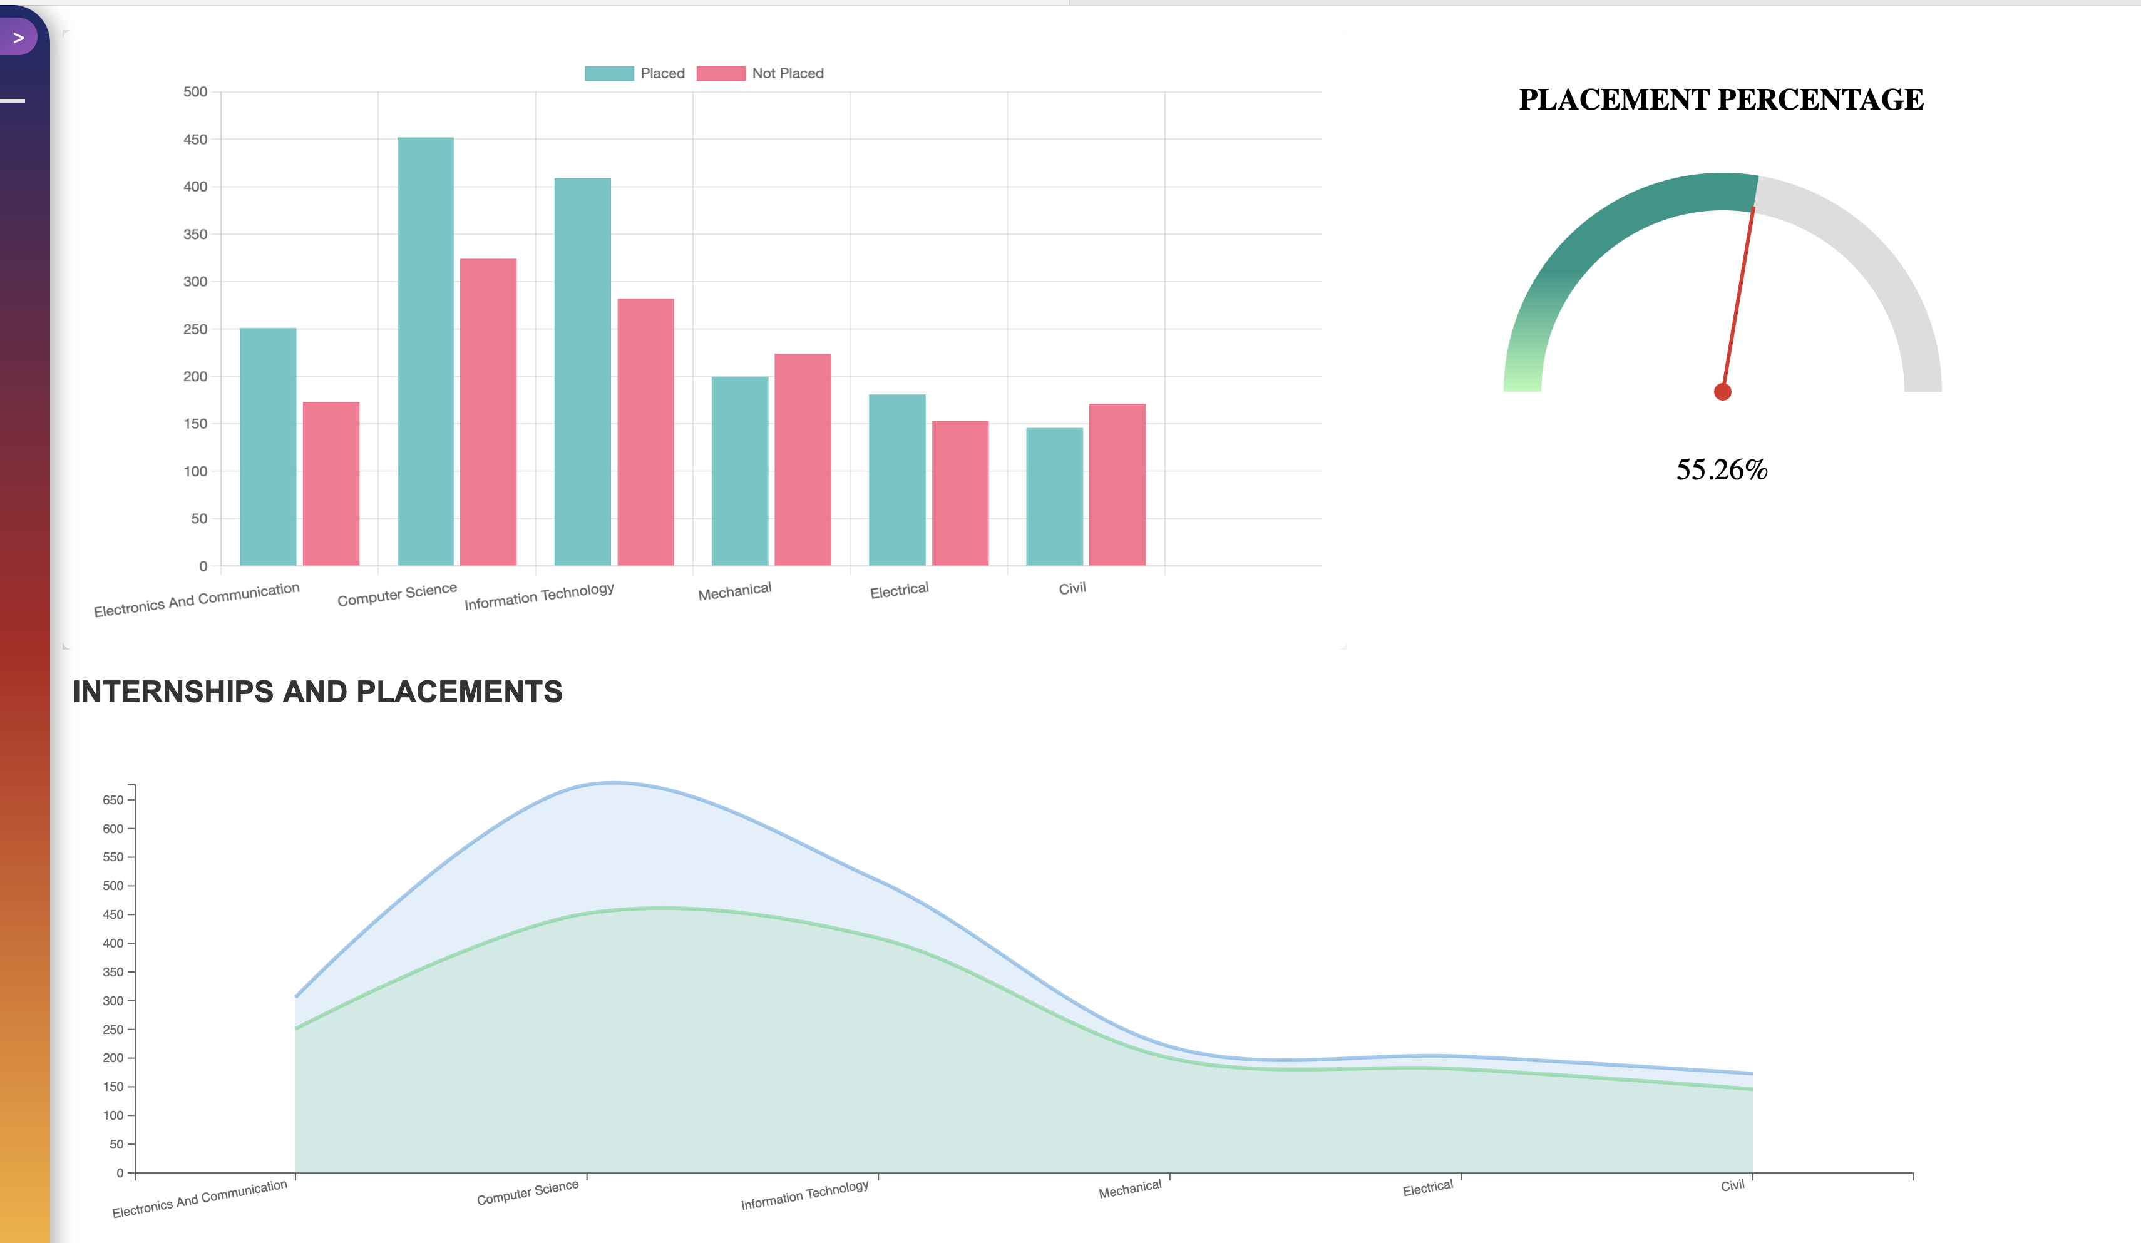
Dashboard
The dashboard includes a bar chart illustrating the placement status (Placed or Not Placed) across different engineering streams.
It also features an area chart displaying the trend of internships completed by students and their corresponding placement outcomes for each engineering stream.
Additionally, the dashboard includes a gauge chart presenting the overall placement percentage of students across all streams.
The combination of these charts provides a comprehensive overview of the placement outcomes, allowing for easy comparison and analysis across different factors and streams.

Slide 10
Conclusion
Data analysis and visualization techniques are crucial for understanding placement trends and assisting stakeholders in decision-making.
The analysis provides a foundation for further exploration and model development to enhance placement prediction accuracy.
Possible improvements include comparing with other visualization techniques like scatter plots or heatmaps, adding interactive features, and developing predictive models.
Comparing bar charts with scatter plots, area charts with heatmaps, and gauge charts with pie charts can provide insights into their effectiveness for different aspects of placement data analysis.

Slide 11

THANK TOU

